Slide 1
Welcome to US History Talks

Slide 2
Preview : Module 6: A Nation Adrift
Talk | Title | Time Period | Date of Talk
37 | The Great Society | 1964-1968 | May 19th
38 | Vietnam | 1961-1972 | June 2nd
39 | Republican Impasse | 1969-1976 | June 16th
40 | US culture 1960’s and 1970’s | 1960-1980 | July 28th
41 | The Humility Experiment | 1976-1980 | August 4th

Slide 6
Module 5: Leader of the Free World
Talk | Title | Time Period | Date of Talk
30 | Isolationism interrupted | 1939-1941 | January 20th
31 | The European War | 1941-1945 | February 3rd
32 | The Pacific War | 1941-1945 | February 17th
33 | America and the Post War World | 1945-1949 | March 3rd
34 | USA during the 1950’s | 1950-1960 | March 17th
35 | The Cold War | 1950-1960 | March 31st
36 | Camelot…the Kennedy Years | 1961-1963 | April 7th

Slide 7
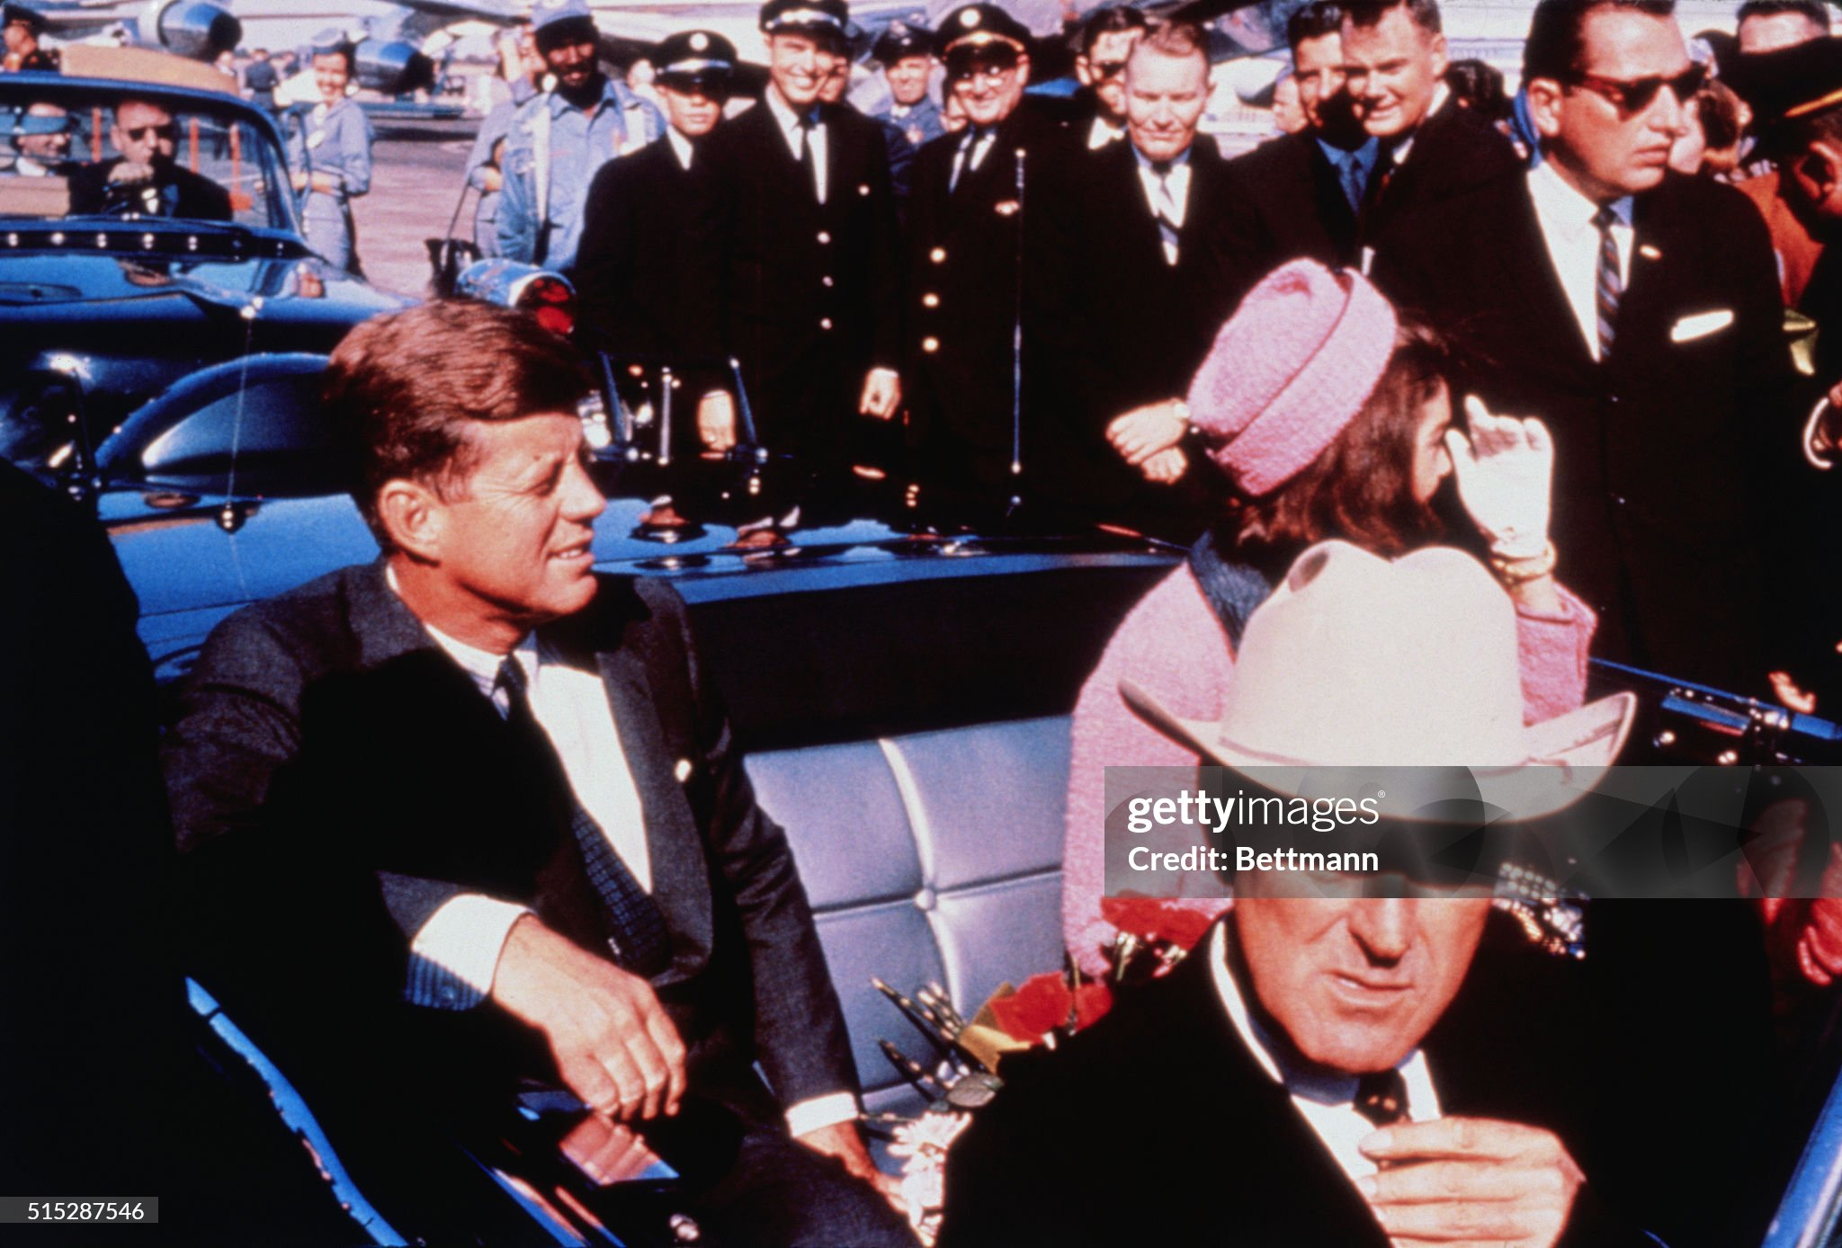
Dallas 11 29 AM November 22nd 1963
America’s most popular President & wife Jackie motorcade
Promoting Civil Rights reforms in South with VP Johnson in car
One minute later he will be dead

Slide 8
Talk 36: Camelot: The Kennedy Years 1960-1963
Kennedy family
The Rise to power
Limits of Office
Crisis and Recovery
Last days
Recommended Reading: Robert Dallek: John Kennedy: An Unfinished Life

Slide 9
The Kennedy Family

Slide 10
Origins
Patrick and Bridget Kennedy emigration from Ireland 1849
Refugees from potato famine
Settle in Boston….Cooper/ barrel makers
Patrick dies from cholera….Bridget buys stationary store…grocery….liquor store
PJ Kennedy (1858-1929)
Only surviving son …to work at 14..at shop and stevedore…working on docks
Uses savings to buy liquor store
Expands to importing whisky…prosperous middle class
Enters local politics…state representative and Senator
Marries Mary ….5 children
It will Joseph Kennedy , PJ’s oldest son who will create the Kennedy wealth

Slide 11
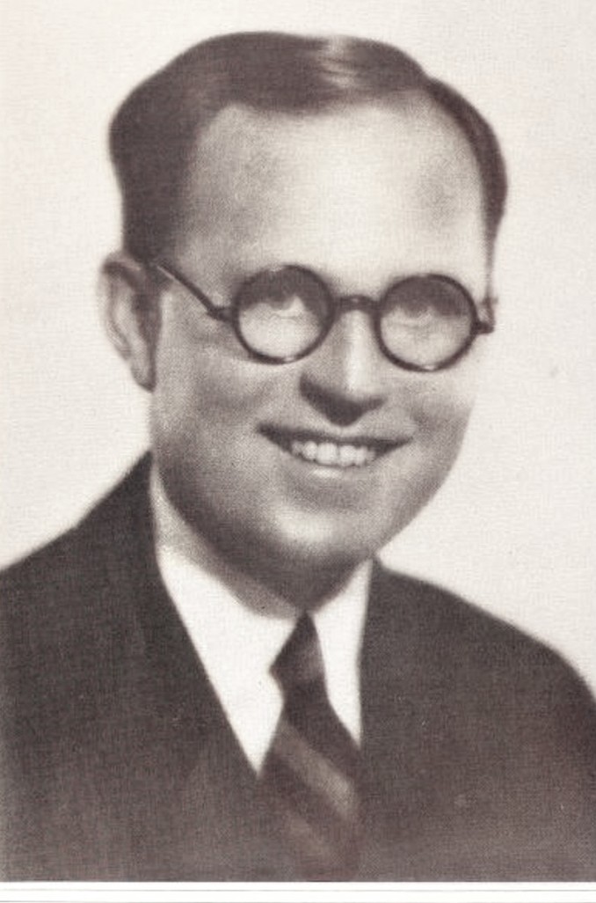
Joe Kennedy(1888-1969)
Joe Kennedy 1928
Private Catholic School/ Harvard …to business.
Bank examiner…PJ major stock holder
youngest bank.. ….Bank President 1917 (age 29)
…invest in steel/ port…WW1 profiteer
…Democrat party member/ donations FDR
Real estate, stock investor
….”stock washer”..insider training
..shorts investments prior to 1929 crash
To Hollywood 1930’s……buys studios
..frames Pantage Owner to buy stock
…donates to FDR Democratic Party
Worth £2Bn..(2024)…
FDR Appoints to SEC (“fox guarding chickens”
…Appointed ambassador to UK 1938
….Isolationist….Britain defeated…Hitler contact
FDR fires Joe…acting vs interest of USA
….dedicates life to getting son to White House

Slide 12
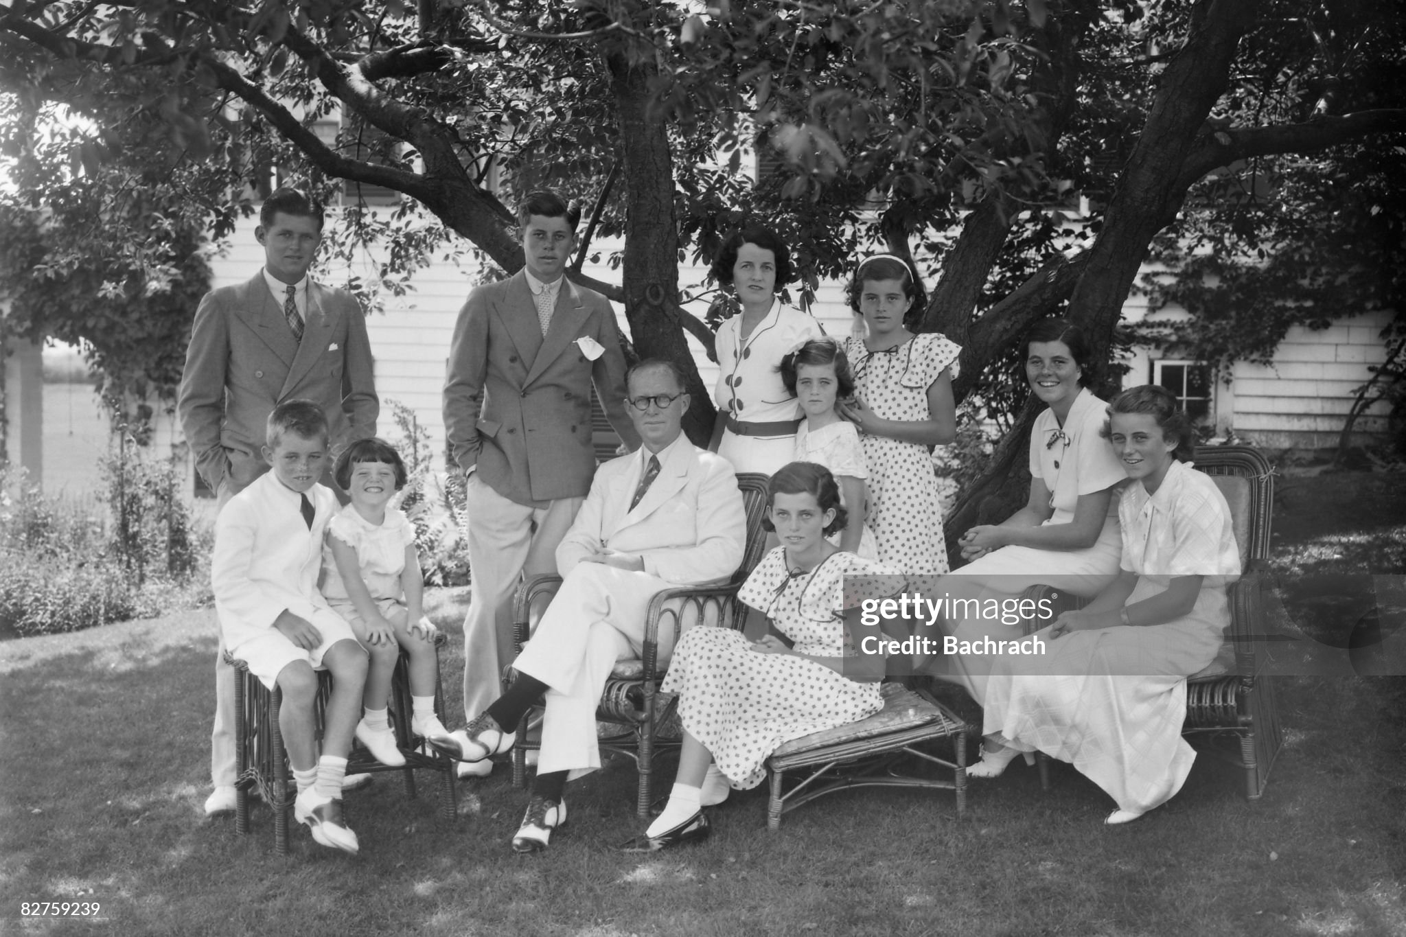
Kennedy Family 1938….”American Royalty”
Joe Marries 1st cousin
Rose FitzGerald 1914
…devout Catholic
…9 children
Joe JR
Rose
Ultra competitive family
….success required
Joe
Promiscuous lifestyle
…known to Rose
…and to children
Open joke for female
Visitors:“keep
doors locked since
Grandpa likes to roam”
Goal: get son in
White Hose

Slide 13
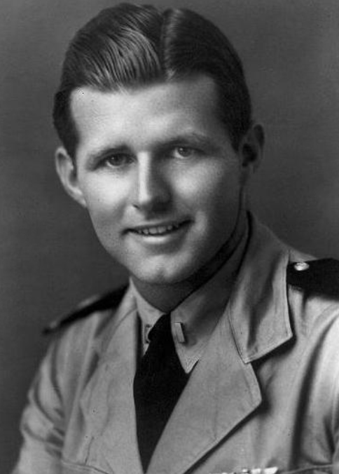
Joe Kennedy Jnr (1915-1944)
Joe Kennedy Jnr 1944
Oldest Son…Joe targets for President
….Private education…Harvard..athlete
..London School economics
Grand tour of Europe
….impressed with Nazi Germany
sterilisation of non perfect a “great thing
that "will do away with many of the
disgusting specimens of men."
Joe Snr ensure Joe JR delegate 1940
Democratic Convention
War Breaks out 1941….Joe Snr:military
Career needed for future in politics
…to UK 1943 Air force

Slide 14
Joe JR
Rose
Joe
Rosemary

Slide 15
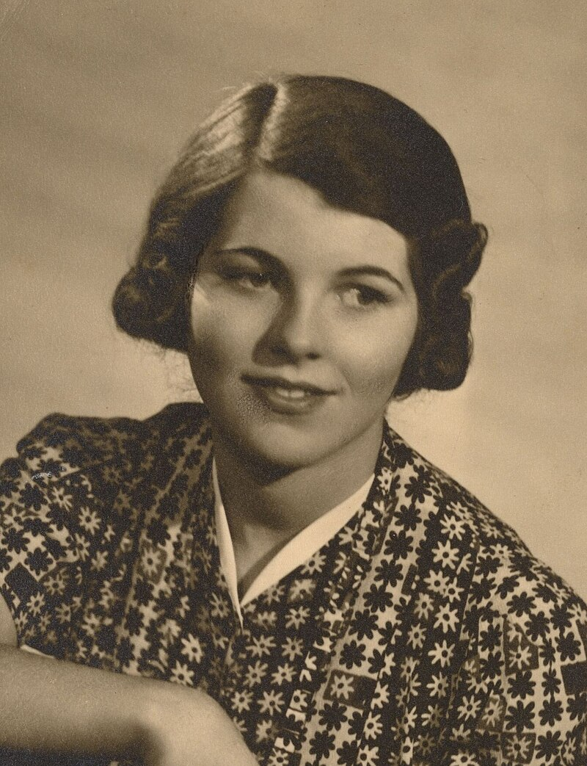
Rosemary Kennedy (1918-2005)
Development delays
…to special schools
…full time tutors
Rosemary aged 20
Active life
…tea parties, ..theatre.
…limited reading
To UK to stay with Joe Sr
….presented to King
..falls over/returns to US
Joe Snr
…“Increasingly difficult & irritable
…arranges lobotomy 1942
Institutionalised.
..unable to speak
...reduced to permanent 2 yr. old
…dies in home for incapacitated

Slide 16
Joe JR
Rose
Kathleen
(Kick)
Joe
Rosemary

Slide 17
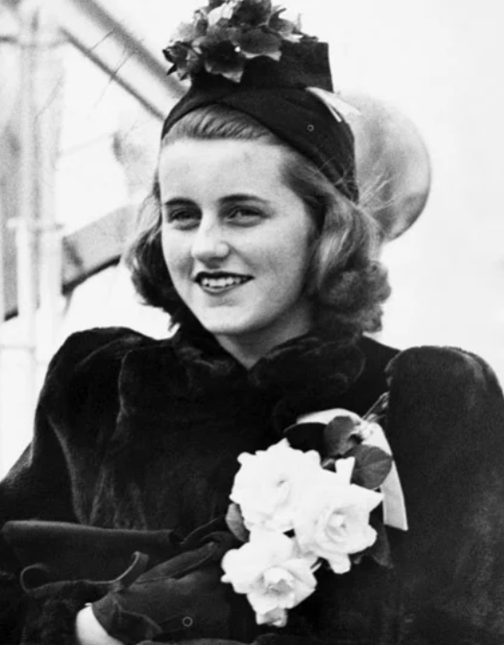
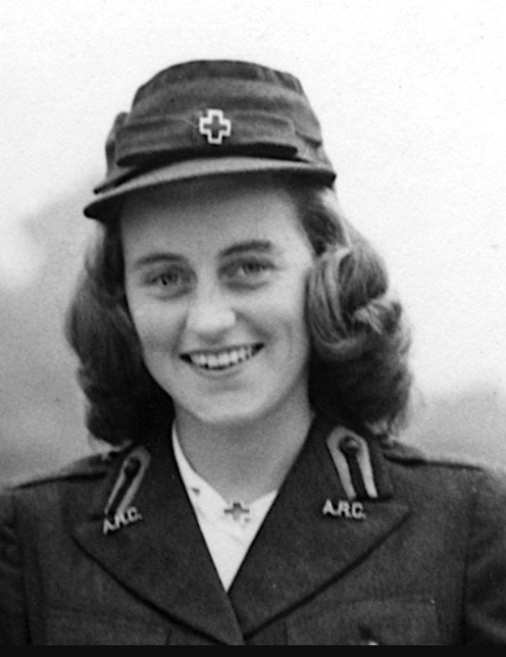
Kathleen (“Kick”) Kennedy (1920-1948)
Private education
…Catholic school. Loses faith
Joins Joe Snr UK
…..debutante of year 1938
…dates Duke of Devonshire (William Cavendish)
Returns to US 1940
…. Returns up 1944. Red Cross
….marries William
….. Marchioness of Devonshire
……family disowns…English, ……Protestant
…only attendee Joe JR
Debutante of the year
1938
Kathleen Red Cross
1944

